Slide 1
Introduction to
Web Services Testing

Slide 2
Agenda
What is Web Service used for?
What is the main features of Service Oriented Architecture?
Using of SOAP and HTTP protocols, XML and WSDL languages
Main Features of Web Service testing
Overview of automated testing tools
Testing Web Services with soapUI application

Slide 3
Glossary
Web Service is a method of communication between two devices over the web.
Service Oriented Architecture (SOA) is an architecture that provides a way for consumers of services, such as web-based applications.
Simple Object Access Protocol (SOAP) is a protocol that defines data transmission rules and call of methods using XML.

Slide 4
Glossary
Web Service Definition Language (WSDL) is a meta-language that is using to describe a Web Service.
Extensible Markup Language (XML) is a markup language for storing structured data, sharing information between the programs, creation on its basis a specialized markup languages.
Hypertext Transfer Protocol (HTTP) is an underlying protocol of the World Wide Web. Defines how messages are formatted and transmitted over a TCP/IP network for Websites.

Slide 5
Service Oriented Architecture
Service Provider
Service request
Service Consumer
Service response
Implementation
Web Service

Slide 6
Requirements to Web Services architecture
Detection
Description
Format of messages
Coding
Delivery

Slide 7
Delivery. HTTP protocol
Benefits:
Stateless
don't need to retain information about users between requests
don’t depend on the continuity of the connection between client and server
Prevalence

Slide 8
Format of messages. SOAP protocol
SOAP protocol provides a standard way to message packaging
HEADER
BODY
Benefits
don’t depends on programming languages
don’t depends on transport protocol
cross-platform interoperability
use of existing industry standards

Slide 9
XML Schema
XML Schema defines the structure of XML document

Slide 10
WSDL
WSDL is XML-document which fully describes a Web Service

Slide 11
Service Oriented Architecture
Directory
WSDL
Service Description
SOAP
SOAP
Service Provider
Service request
Service Consumer
XML
Service response
XML

Slide 12
Особенности тестирования
Web Services
UI-less
Integration Testing
Compliance to standards
Cross-platform
Reliability

Slide 13
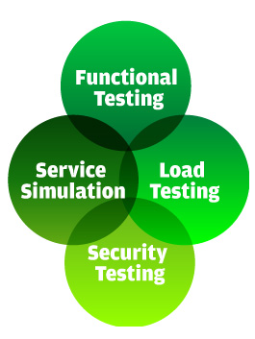
soapUI
SOAP UI is a tool that allows to test Web Services, call the interface methods and analyze the results of testing.
Functional Testing helps to verify whether Web Services works as they should
Load Testing makes it possible to study how your Web Service behaves under different load conditions
Security Testing ensures that your Web Services are protected from vulnerabilities
Service Simulation gives you the possibility to simulate systems not available.

Slide 14
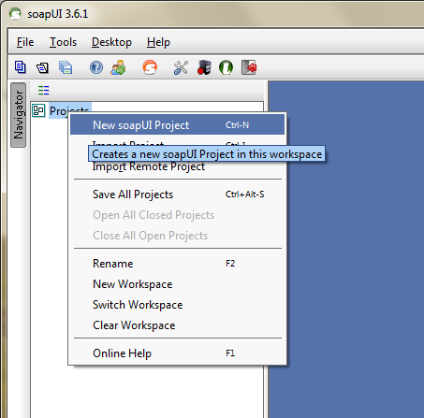
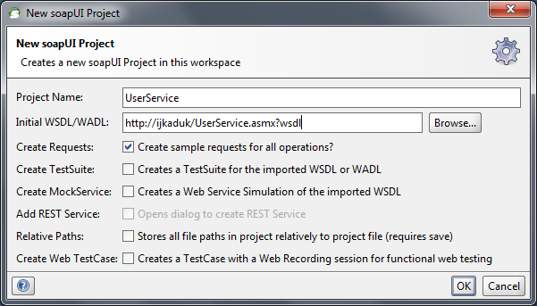
soapUI - Functional testing

Slide 15
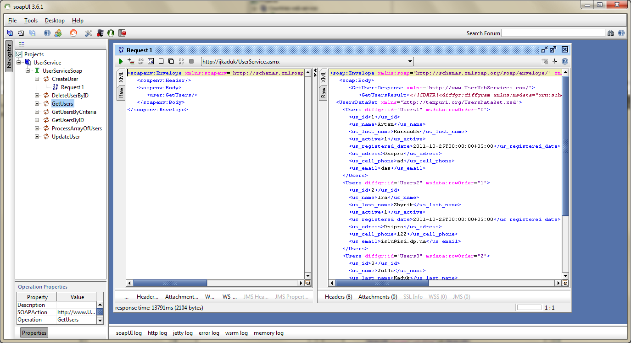
soapUI - Functional testing

Slide 16
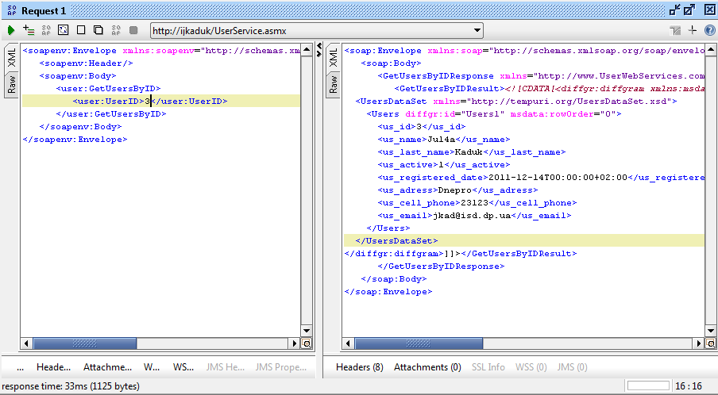
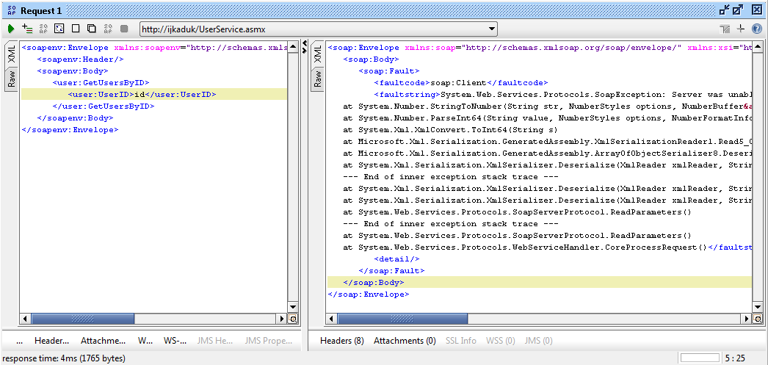
soapUI - Functional testing

Slide 17
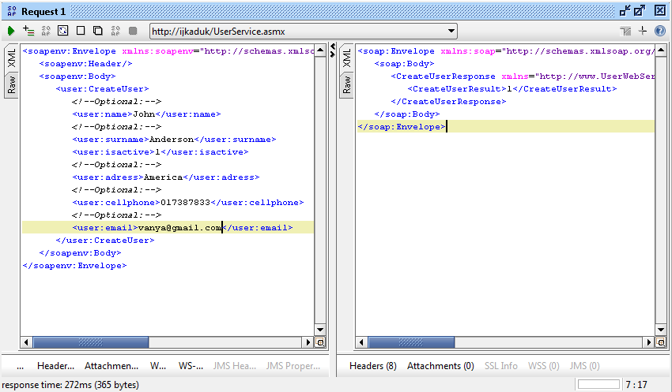
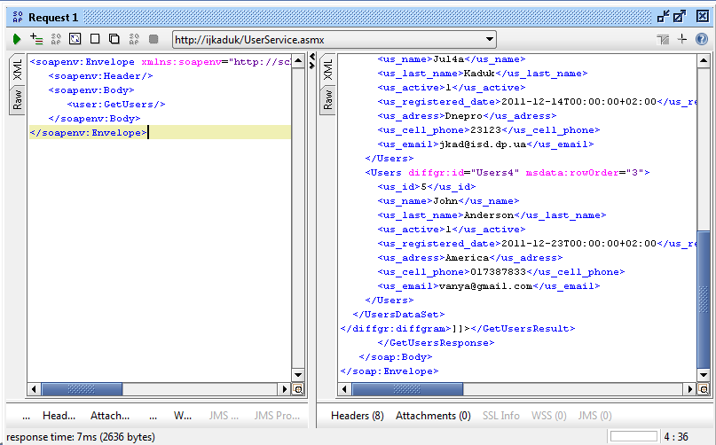
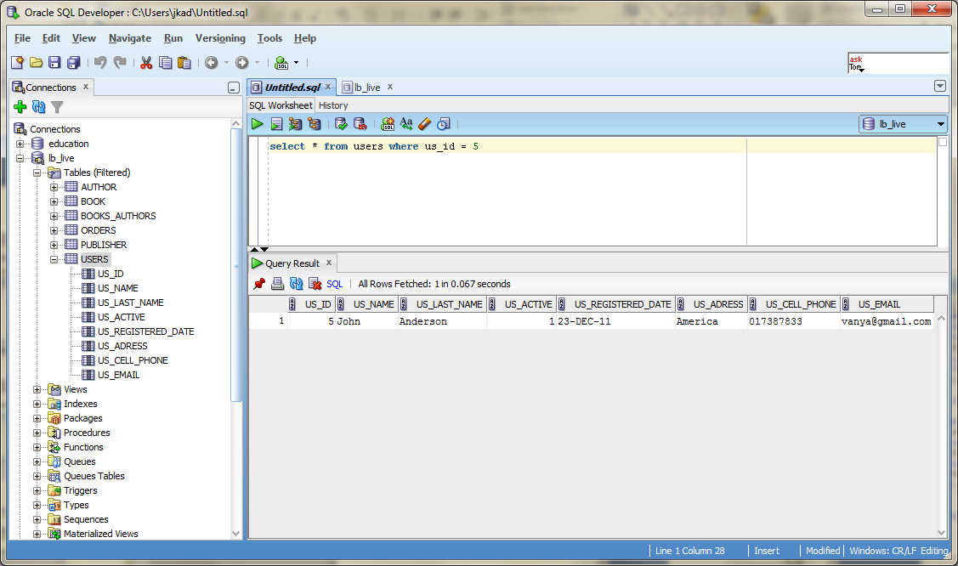
soapUI - Functional testing
Step 1
Step 2
Step 3
Creation of new user
Check addition of user by soapUI request
Check addition of user by SQL request

Slide 18
Quiz
Give definition of the following concepts: Web Service, SOA, SOAP protocol, HTTP protocol, WSDL, XML Schema
Describe the main features of SOA.
What is the sense of using HTTP protocol?
What protocol provides the format of sending messages?
What is the purpose of using XML Schema language?
What requirements are necessary for usong automated testing tools?
What are the main aspects of Web Service testing?

